Slide 1


HealthConnect: Connecting Patients with Doctors
Revolutionary telemedicine platform launching Q4 2025. We're addressing a Ksh.36B virtual healthcare market opportunity in Kenya.
Founded by a team at PLP software developers. Seeking Ksh.20M seed investment for countrywide expansion.
by Stephen Okoth
SS
Notes:
1

Slide 2

Problem & Solution
The Problem
Our Solution
63% of patients wait 3+ weeks for appointments
Mobile platform connecting patients to doctors/specialiasts 24/7. Video consultations, prescriptions, and follow-ups in one app.
80% of non-urgent care could be virtual
Rural patients travel 4+ hours to specialists
Notes:
2

Slide 3
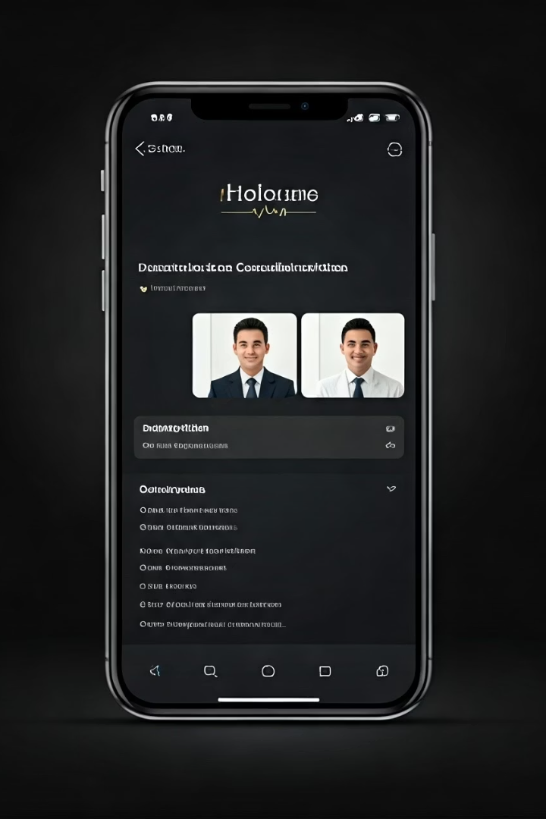





Product Features
App-based screening
HIPAA/DHA-compliant Video
E-prescriptions
Reduces consultation time by 30%
Integrated with 85% of Kenya pharmacies
Connect with 3,000+ physicians securely
Quick Access
Average wait time: under 20 minutes
Notes:
3

Slide 4






Target Market & Size
Secondary Market
72% rural Kenyans with limited healthcare access
Primary Market
14M insured Kenyan principal members and 22.8M beneficiaries ages 25-55
Tertiary Market
36.2% Kenyans with chronic conditions
Ksh. 36.13 B telemedicine market by 2026 (12.26% CAGR). Capturing just 5% = Ksh. 1.8 B annual revenue.
Notes:
4

Slide 5

Competitive Landscape
Feature
HealthConnect
ConnectMed
Afyabora
Doctor-Patient Matching
Yes
Limited
No
Insurance Integration
80% of carriers
60% of carriers
50% of carriers
Specialist Network
500+ specialists
200+ specialists
150+ specialists
Avg. Consultation Cost
Ksh.45
Ksh.70
Ksh.65
Notes:
5

Slide 6
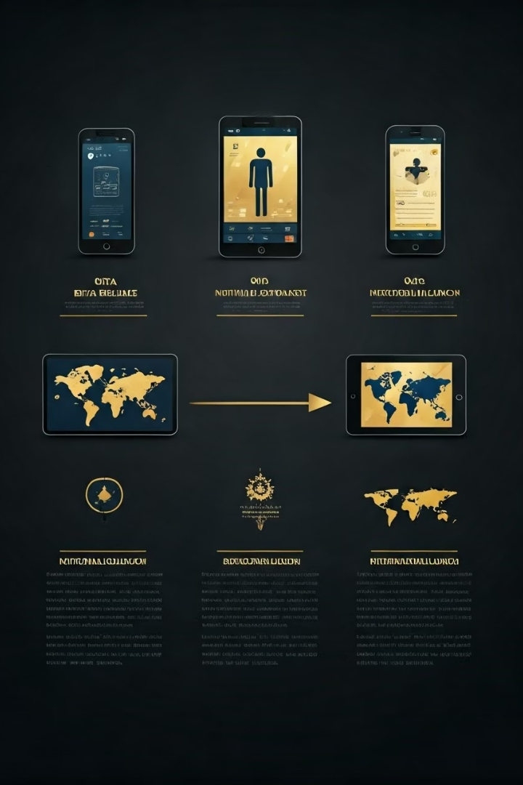




Traction & Roadmap
Beta Test - Now
5,000 users, 92% satisfaction, 4.8/5 app rating
Q4 2025
Full launch in 10 key metropolitan areas
2026
Nationwide expansion + chronic care management
2027
International expansion + predictive care AI
Notes:
6

Slide 7








Business Model
Profitability
Projected Q2 2027
Enterprise Partnerships
3 Fortune 500 employers
Doctor Revenue Share
85/15 split with physicians
Subscription Model
Ksh.5000-Ksh.20,000/month options
Projected revenue: ksh30M by end of 2026, Ksh.55M by 2027.
Notes:
7

Slide 8

Team & Ask
Stephen Okoth - CEO
Dr. Samuel Atandi
Chief Consultant, KNH
Chief Development Officer
Dr. Lence Were
Telemedicine Expert with a start-up Ksh. 5B.
Ksh.20M
Total Seed Ask
Ksh.18.5M
Engineering Team
Ksh.800K
Doctor Network
Ksh.700K
Marketing
Notes:
8

